Slide 1
Accessing freely available public datasets from The Cancer Imaging Archive
Justin Kirby
Technical Project Manager
Email: justin.kirby@nih.gov

Slide 2


Data sharing enables better science

Slide 3
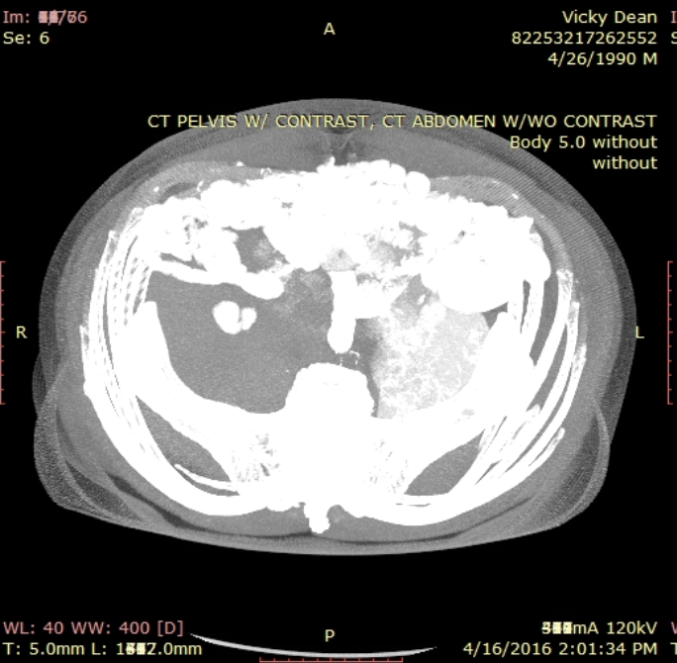
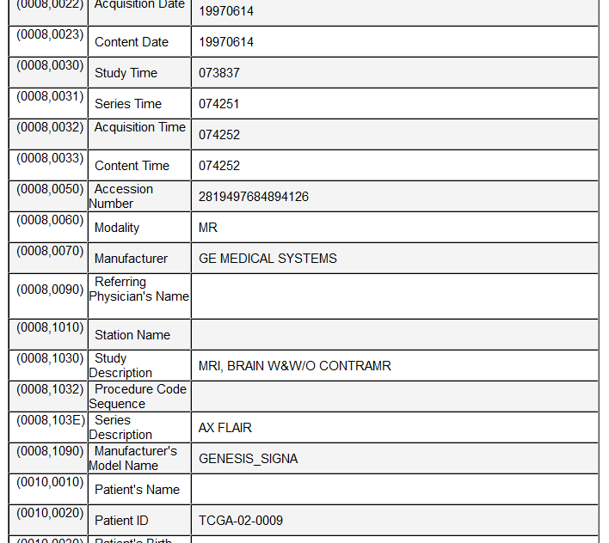
Sharing radiology data isn’t easy!
PHI can appear in hundreds of places in DICOM
Pixel data
Dates
Identifiers
Descriptions
“Private tags” with ambiguous proprietary content
Simplistic de-id approaches throw away important acquisition metadata that prevents reuse
Convert data to NIFTI, PNG, JPEG
Retain DICOM, but use overly aggressive cleaning methods

Slide 4
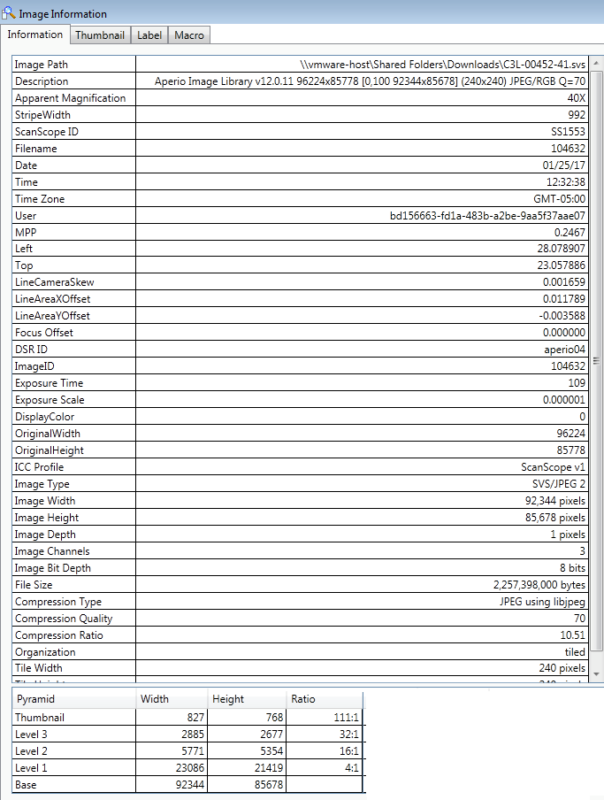
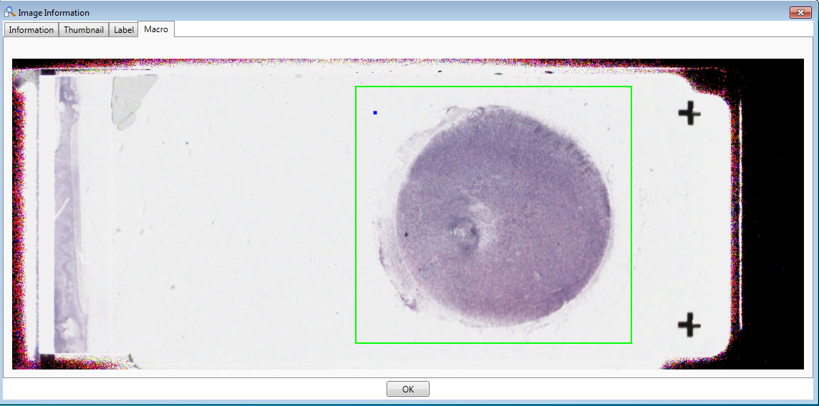
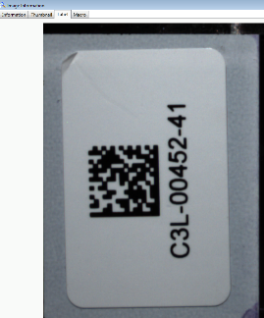
Histopathology image de-identification
Image metadata
Image labels/barcodes/macro images
Pixel data
Proprietary formats means using various tools
for curation
Jane Doe
Dx = AML

Slide 5
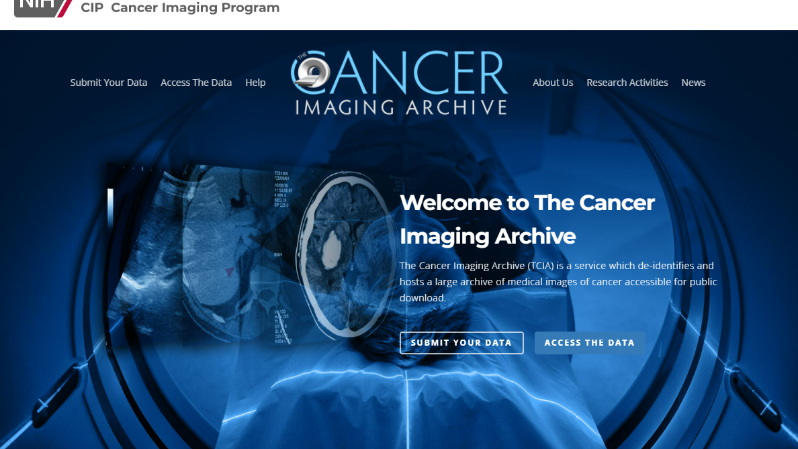

Slide 6
TCIA Services
De-identification and Quality Assurance Process.
Live Submission Support from beginning to end.
Reliable, Persistent Hosting
Data citations for findability and academic credit
Dedicated Curation Teams
Custom De-identification Software configured and installed at sites
Full documentation and Training
IRB coverage and Data agreements

Slide 7

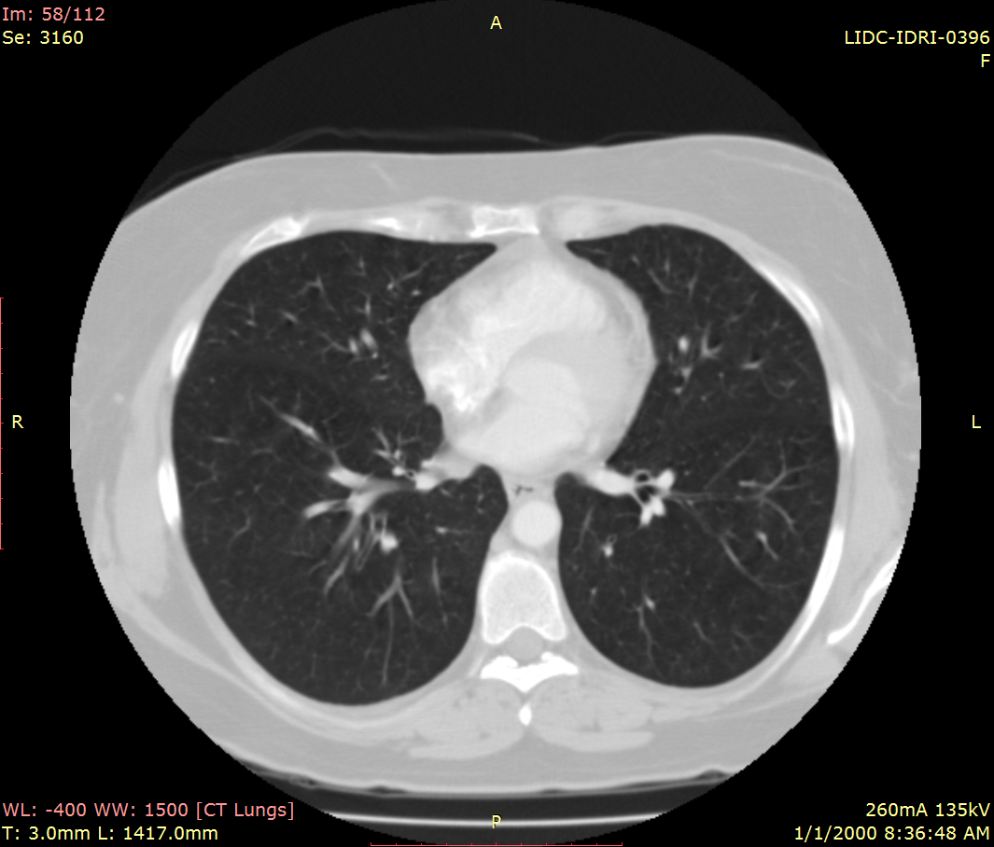
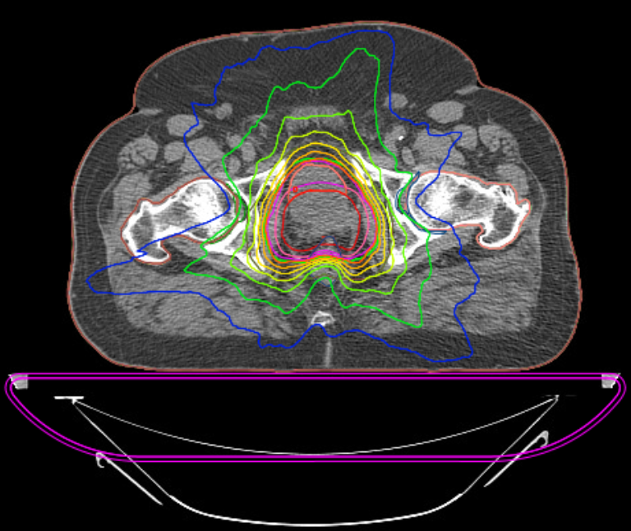
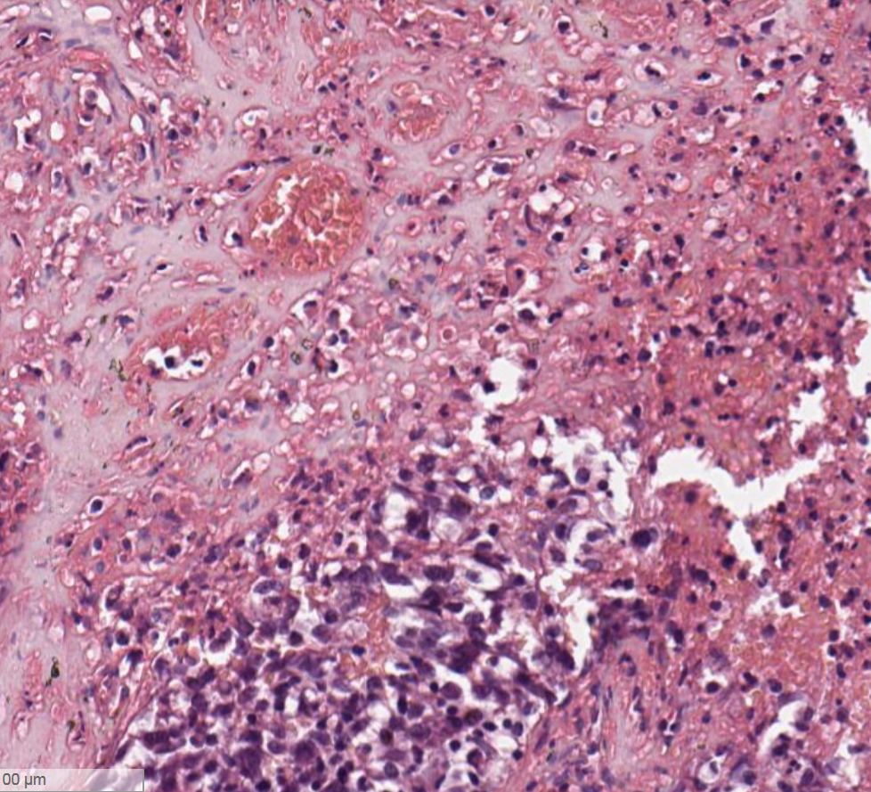
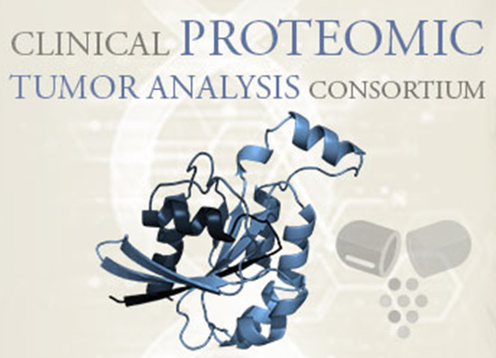

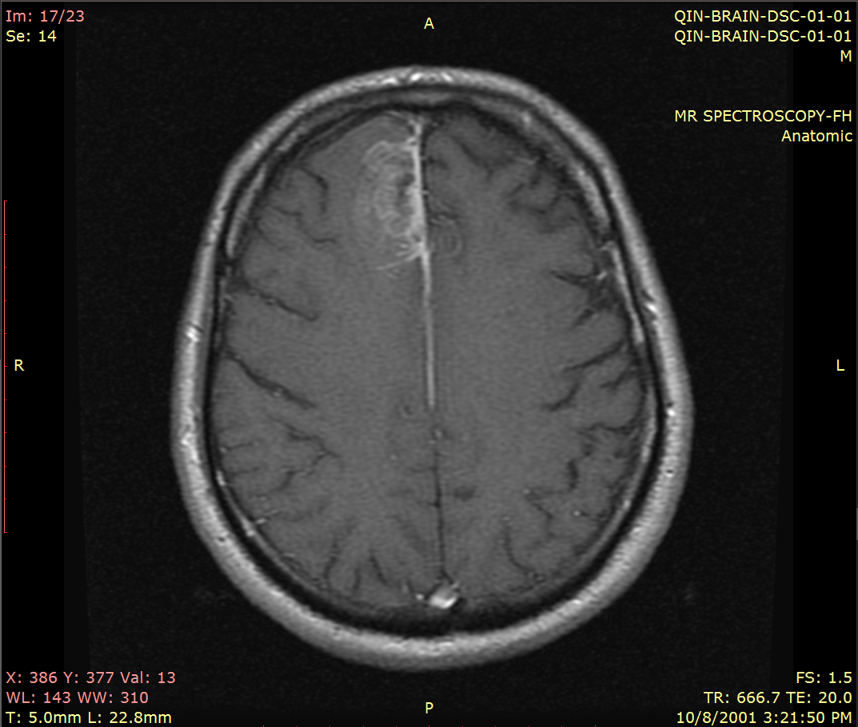
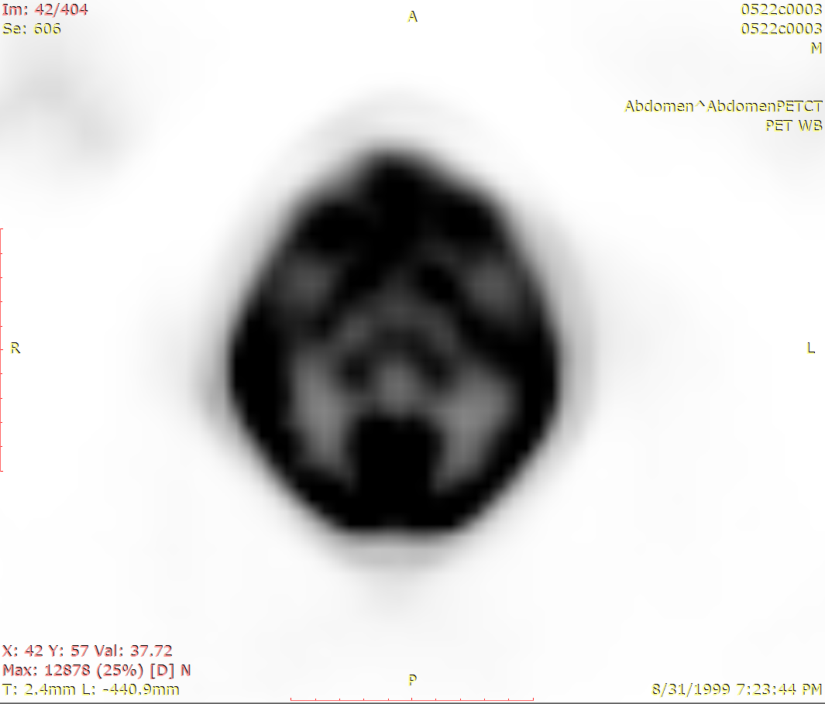
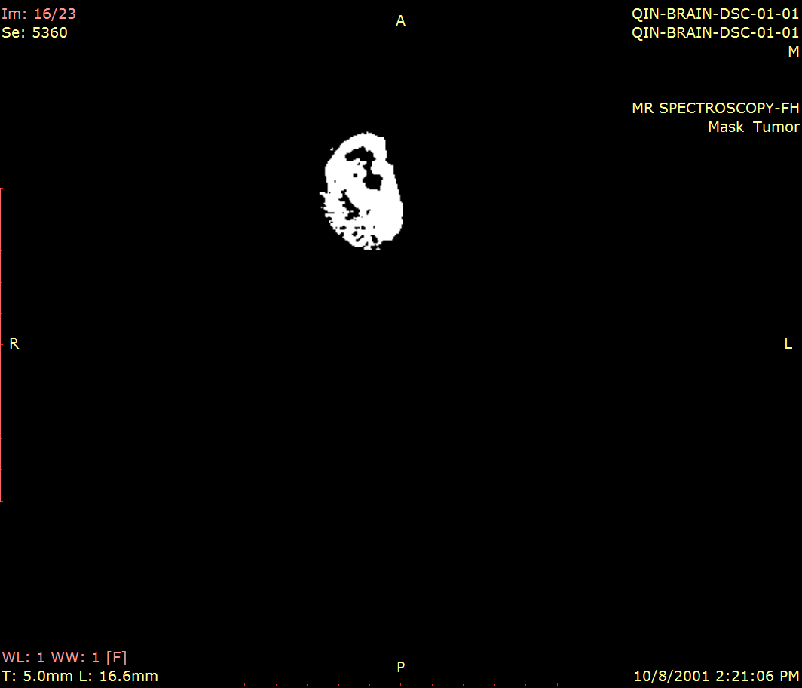

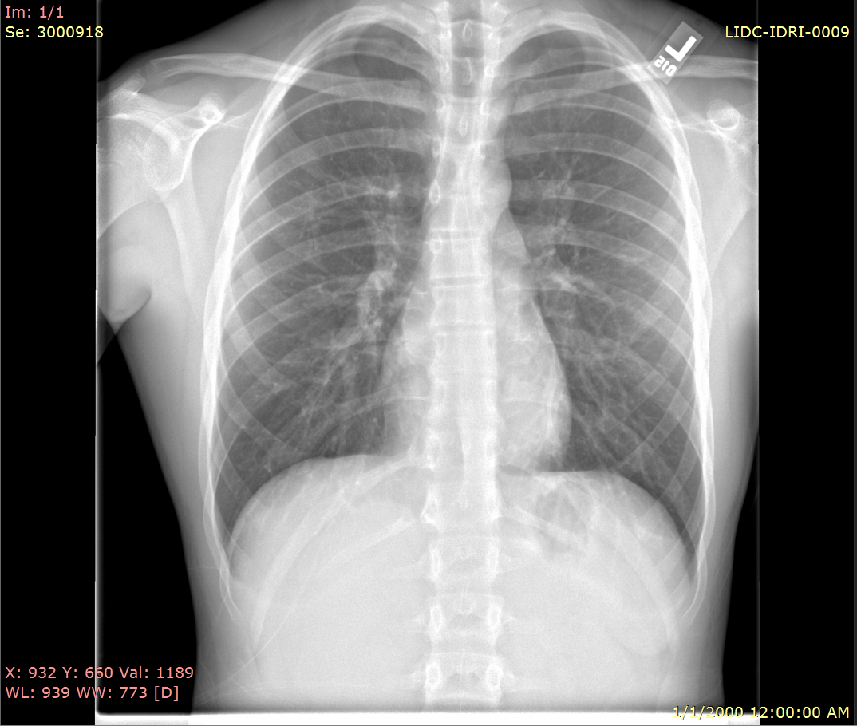
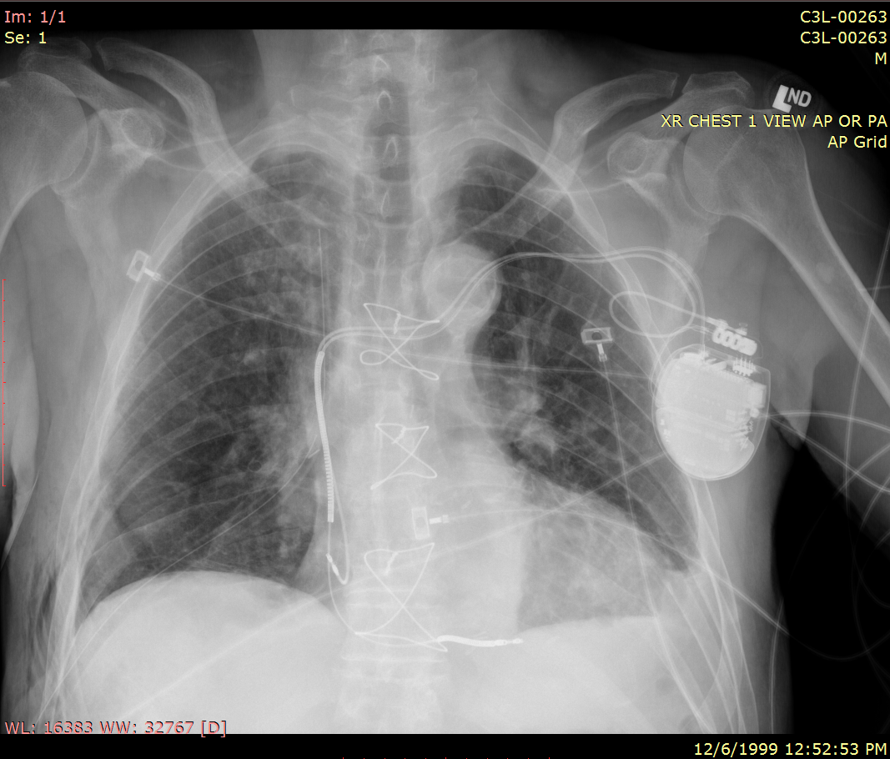
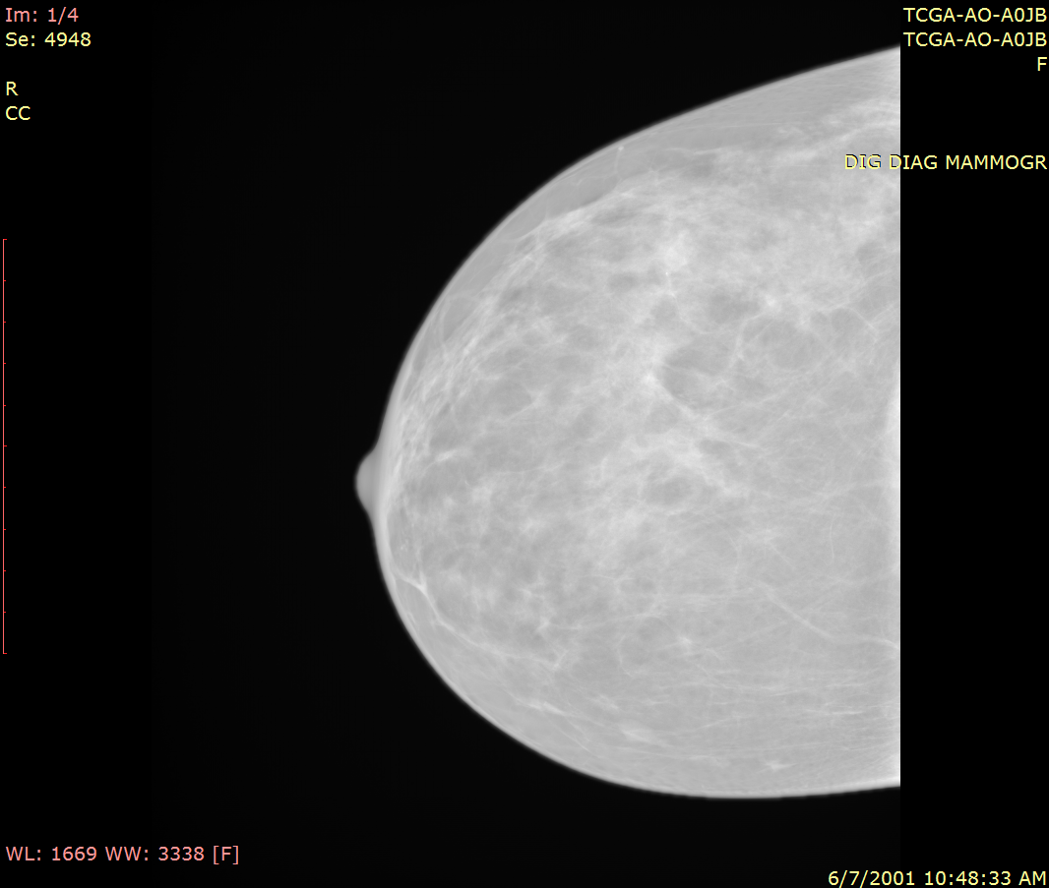



TCIA Supports Radiology and Histopathology Imaging in Major NCI Research Initiatives
CT
RTSTRUCT
RTDOSE
WSI
MRI
PET
SEG
Quantitative Imaging Network
National Lung Screening Trial
Community Initiated
DX
CR
MG

Slide 8
Acknowledgements
NCI Cancer Imaging Program
Janet F. Eary, M.D.
Lalitha K. Shankar, M.D., Ph.D.
Fredrick National Laboratory for Cancer Research
John Freymann
Justin Kirby
Ramesh Avula Ph.D.
Brenda Fevrier-Sullivan
Pam Angelus
Luis Cordeiro
Michelle Tacconelli
University of Arkansas
Fred Prior Ph.D.
Kirk Smith
Lawrence Tarbox Ph.D.
Dwayne Dobbins
Jeff Tobler
Joseph Utecht
Sonya Utecht
Julie Frund
Tracy Nolan
Quasar Jarosz
Brittney Camp
Erica Bilello
Claren Freeman
Natasha Honomichl
Geri Blake
Erica Bilello
Michael Rutherford
Emory University
Ryan Birmingham
Matthew Reyna Ph.D.
Stony Brook University
Joel Saltz M.D., Ph.D.
Erich Bremer
Contractors
John Perry
Betty Levine
NBIA Team (NCI/FNLCR/Ellumen)
Qinyan Pan
Russ Rieling
Carolyn Klinger
Martin Lerner
Tin Tran
Imaging and Radiation Oncology Core
Michael Knopp M.D., Ph.D.
Connor Nealer

